Slide 1
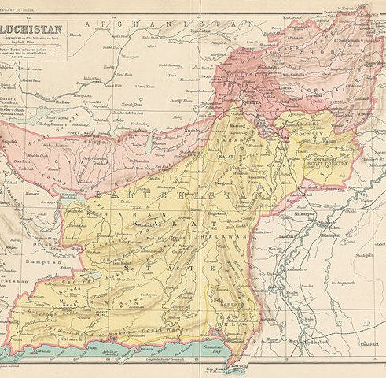
Hydrological modeling of Baluchistan and depiction of groundwater potential of Kachhi district, Baluchistan using Multi-criteria decision analysis and it's corresponding drought risks
Mudassir Aqeel
Areeba Quddusi
Maliha Siddiqui
S. Owais Ali Shah

Slide 2
Table of Contents
Serial No. | Topic | Page No.
1 | Data | 4
2 | Area of Interest Map | 5
3 | Hydrology in Environmental & Ecological Continua | 6
4 | Hydrological Modelling | 7
5 | Basin | 8
6 | Slope | 9
7 | Stream flow | 10
8 | Water Shed | 11 – 12
9 | Drainage Density | 13 – 14
10 | Types of Hydrological Modelling | 15
11 | Area of Interest Map | 16
12 | Drought Risk Assessment | 17

Slide 3
Serial No. | Topic | Page No.
13 | Normalized Difference Vegetation Index | 18
14 | Groundwater | 21
15 | Depiction of Groundwater potential zones | 22
16 | Geology | 23 – 24
17 | Slope | 25 – 26
18 | Lineament density | 27 – 28
19 | Soil Type | 29 – 30
20 | LULC | 31 – 32
21 | Drainage Density | 33 – 34
22 | Groundwater Potential | 35
23 | Analytical Hierarchy Process | 36 – 40
24 | References | 41

Slide 4
Data
The Data is extracted for the province Baluchistan (28.4907° N, 65.0958° E) of Pakistan and for further analysis we chose the Kachhi District (29.2293° N, 67.6662° E) in Baluchistan also known as Bolan.
For SRTM Digital Elevation Models https://srtm.csi.cgiar.org/
For Landsat Band Images https://earthexplorer.usgs.gov/
For Administrative boundaries https://www.diva-gis.org/gdata
For Soil Map https://www.fao.org/soils-portal/data-hub/soil-maps-and-databases/faounesco-soil-map-of-the-world/en/
For Geological Map https://certmapper.cr.usgs.gov/data/apps/world-maps/

Slide 5
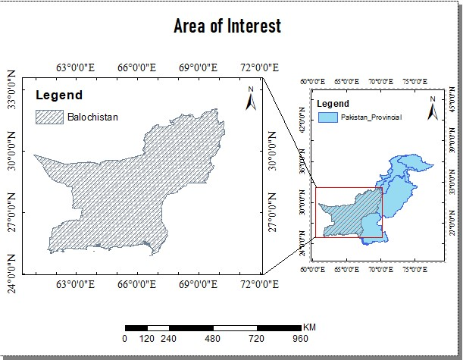
Pakistan lies in a temperate zone and its climate is as varied as the country's topography—generally dry and hot near the coast and along the lowland plains of the Indus River, and becoming progressively cooler in the northern uplands and Himalayas.
Baluchistan is the largest province in terms of land area, forming the southwestern region of the country, but is the least populated.

Slide 6
Hydrology in Environmental & Ecological Continua
In the environmental continuum, water plays a central role and brings soil and air closer. Water shapes the landscape and turns into water vapor. It sustains the ecological continuum. Therefore, hydrology is the core of environmental and ecological continua. It is the environmental and ecological problems and growing public concern for their solution that placed increasing demands on hydrologic models. It is these demands that triggered the development of comprehensive hydrologic models, both surface water and groundwater, with details in up to 3 dimensions. Emergence of hydrology as a science in its own right may partly be ascribed to the role that it plays in addressing a range of environmental and ecological problems and to its being a critical component of the environmental and ecological continua. Furthermore, these problems have helped either integration or bringing closer of seemingly disparate areas. For example, there is growing acceptance that biological and chemical transport processes are as much a part of hydrology as physical processes. Similarly, geomorphologic processes underlying drainage networks are very much a part of hydrology.

Slide 7
Hydrological Modelling
GIS provides representations of these spatial features of the Earth, while hydrologic modeling is concerned with the flow of water and its constituents over the land surface and in the subsurface environment. ... Hydrologic models are mathematical representation of the flow characteristics.
A hydrological model can generate stream flow estimates and trends over long periods. While a model can generate historical current or natural stream flow records, a model can also be used to generate future yields or scenario modelling.

Slide 8
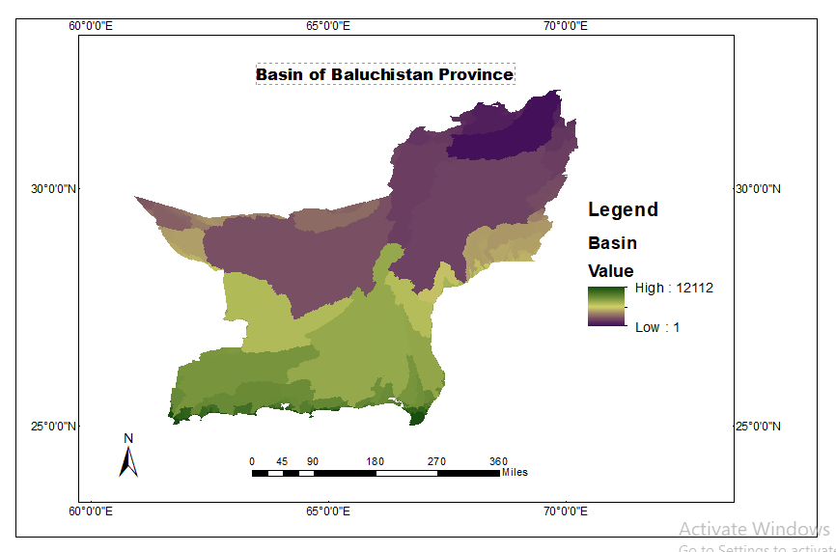
BASIN
Drainage basins are the principal hydrologic unit considered in fluvial geomorphology. A drainage basin is the source for water and sediment that moves from higher elevation through the river system to lower elevations as they reshape the channel forms.
The drainage basins are delineated within the analysis window by identifying ridge lines between basins. The input flow direction raster is analyzed to find all sets of connected cells that belong to the same drainage basin. The drainage basins are created by locating the pour points at the edges of the analysis window (where water would pour out of the raster), as well as sinks, then identifying the contributing area above each pour point. This results in a raster of drainage basins.

Slide 9
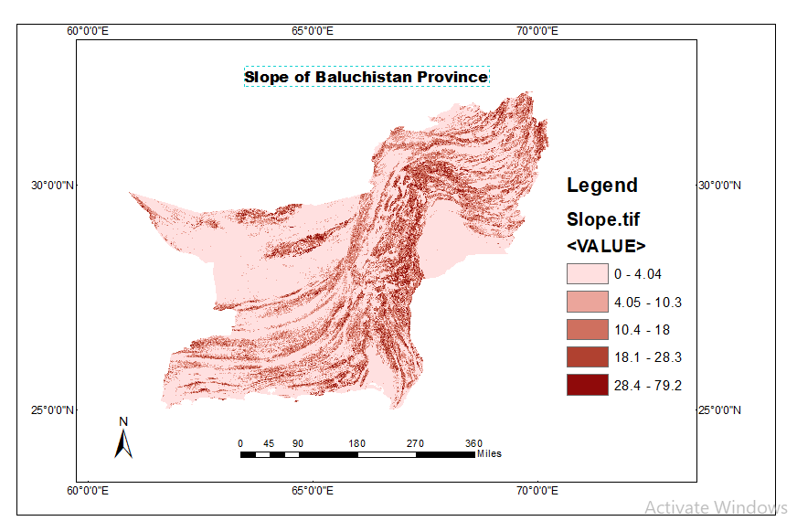
Since water is heavier than air, this increases the weight of the soil. Weight is force, and force is stress divided by area, so the stress increases and this can lead to slope instability. Water has the ability to change the angle of repose (the slope angle which is the stable angle for the slope). Steep slope can increase the flow rate of a waterbody which could lead to increase in soil erosion; moreover, slope has a significant effect on the infiltration rate of groundwater; the amount of infiltration decreases with increase in the slope
SLOPE

Slide 10
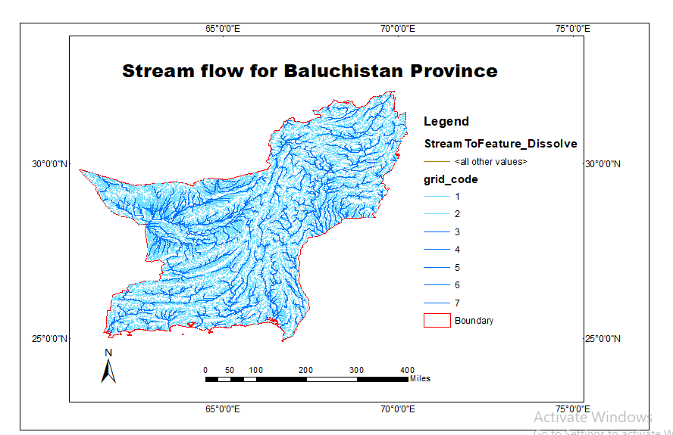
Streamflow, or channel runoff, is the flow of water in streams, rivers, and other channels, and is a major element of the water cycle. It is one component of the runoff of water from the land to waterbodies, the other component being surface runoff. Streamflow is a measurement of the amount of water flowing through a stream or river over a fixed period of time.
STREAM FLOW

Slide 11
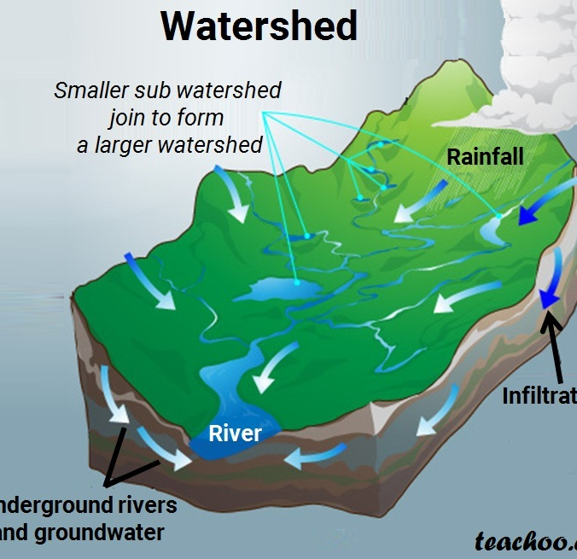
Watershed
In hydrology, the land unit is the watershed, which also may be referred to as a basin or catchment. A watershed is defined as an area of land in which all of the incoming precipitation drains (i.e., “sheds”) to the same place – toward the same body of water or the same topographic low area (e.g., a sinkhole)

Slide 12
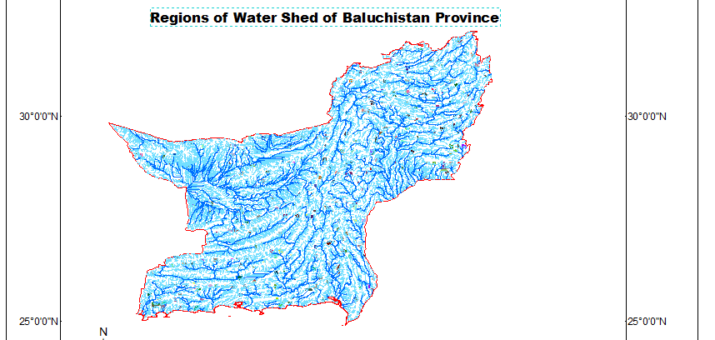

Slide 13
Drainage Density
Drainage density is a quantity used to describe physical parameters of a drainage basin. Drainage density is defined as the total length of channel in a drainage basin divided by the total area
Drainage density depends upon both climate and physical characteristics of the drainage basin. Soil permeability (infiltration difficulty) and underlying rock type affect the runoff in a watershed; impermeable ground or exposed bedrock will lead to an increase in surface water runoff and therefore to more frequent streams. Rugged regions or those with high relief will also have a higher drainage density than other drainage basins if the other characteristics of the basin are the same.
Because flow velocity is higher in the river network, Dd significantly affects the concentration time and therefore the peak flow magnitude. It follows that an increasing drainage density implies increasing flood peaks. More- over, a long concentration time implies more opportunities for water to infiltrate.

Slide 14
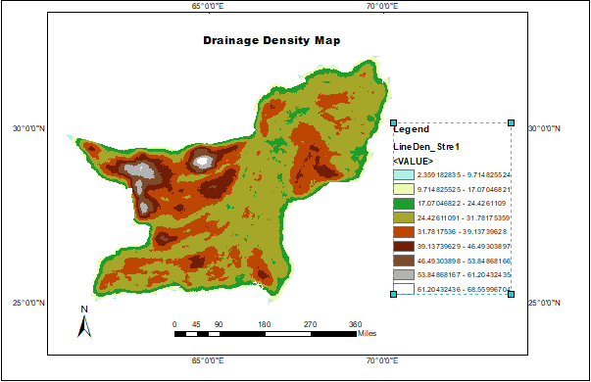

Slide 15
Types of Hydrological Modelling
Flood
Precipitation Estimation
Water Quality
Surface Runoff
Groundwater Potential
Landslide Prediction
Drought Risk
We will further calculate the groundwater potential of a specific zone in our study area(Baluchistan)

Slide 16
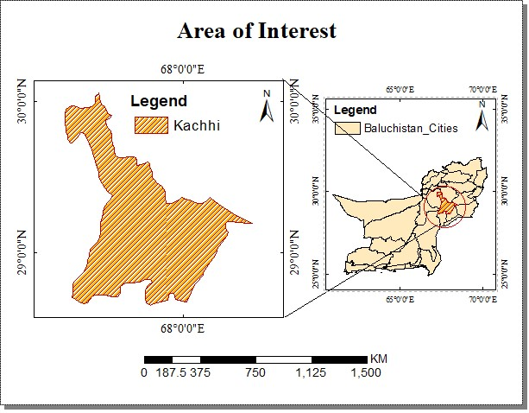
Kachhi District or Kachhi, known until 2008 as Bolan, is a district in central Baluchistan, Pakistan.
The Kachhi Plain is an arid plain with mountain ranges on three sides except to the east

Slide 17
Drought Risk Assessment
Before we head on to delineate groundwater potential zones for Kachhi district we are to asse any drought risk because Baluchistan generally is an arid region and can be severely hot and dry for some regions in the Summer
Vegetation Condition Index(VCI) Is an index used to assess drought risks. VCI compares the current NDVI to the range of values observed in the same period in previous years. The VCI is expressed in % and gives an idea where the observed value is situated between the extreme values (minimum and maximum) in the previous years.
VCI = 100 * (NDVI - NDVImin) / (NDVImax - NDVImin)

Slide 18
Normalized Difference Vegetation Index
The NDVI is a dimensionless index that describes the difference between visible and near-infrared reflectance of vegetation cover and can be used to estimate the density of green on an area of land.
Given Landsat 8 images the formula to calculate NDVI will be
NDVI = (Band 5 – Band 4) / (Band 5 – Band 4)
Where band 5 refers to the near infrared band and band 4 to red band respectively. To calculate VCI we’ll calculate NDVI for three different years. And calculate the historical minimum and maximum NDVI values.

Slide 19
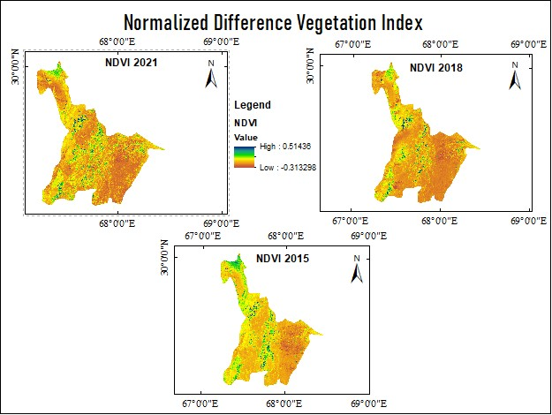

Slide 20
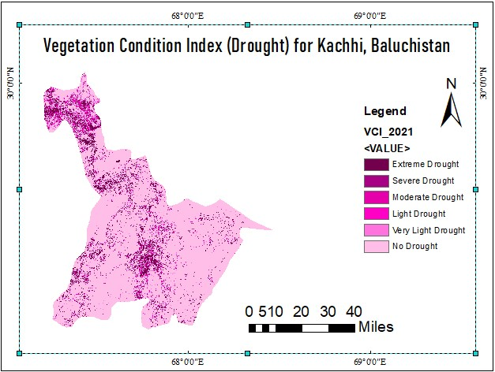
Given our VCI index we can say that there are lower risks of drought throughout the year compared to some regions in the province

Slide 21
Groundwater
Groundwater is one of the most precious natural resources which constitute about 34% of fresh water resources of the globe.
Due to rapid population growth, uneven spatio-temporal distribution of water resources, economic development, and changing climate, the demand for fresh water resource has increased rapidly over the years which have led to water scarcity in many parts of the world
Traditionally, groundwater explorations through drilling, hydro-geological, geological, and geophysical techniques is very common and these techniques are extremely costly and time-consuming.
In addition, these methods of surveys do not always account for the diverse factors that control the occurrence and movement of groundwater.
In recent years, techniques such as remote sensing (RS) and geographical information system (GIS) play an important role in understanding the complex problem of groundwater exploration
by providing systematic, synoptic, rapid and excellent configuration to handle large and complex spatial data

Slide 22
Depiction of groundwater potential zones
Groundwater, a dynamic resource, depends on several factors such as,
Geology
Lineament Density
Soil Type
Slope
Landuse Landcover
Drainage Density

Slide 23
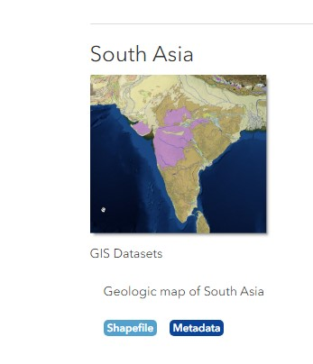
Geology
Geology controls infiltration, movement, and storage of water
We download the geological map of South Asia from the world geological map from United States Geological Survey website and extract the region for our area of interest

Slide 24
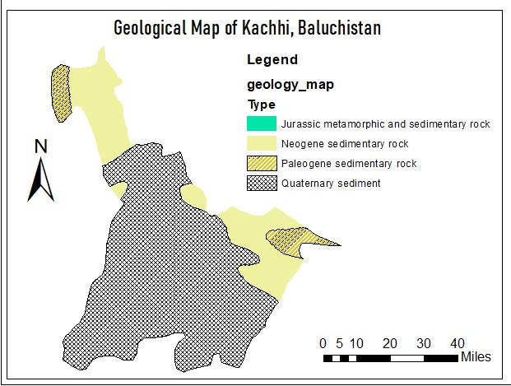

Slide 25
Slope
SRTM DEM image
Spatial Analyst tool Slope
Reclassify & Dissolve based on Grid code
Slope drives the water flow energy

Slide 26
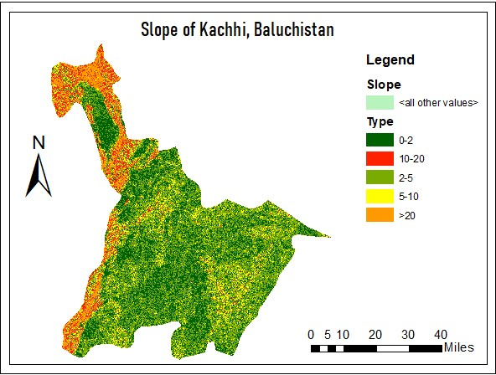

Slide 27
Lineament Density
SRTM DEM image
Spatial Analyst tool Hillshade with different angles
Creating a shapefile and drawing lineaments by observation
Line Density Tool
LD increase hydraulic conductivity

Slide 28
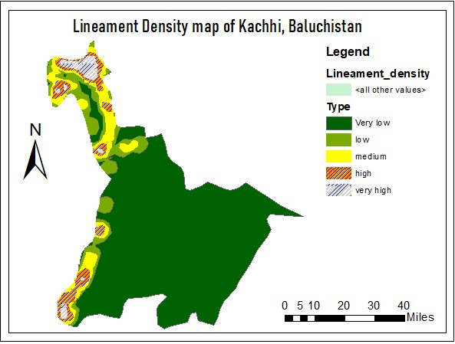

Slide 29
Soil Type
Download FAO World Digital Soil Map
Extract our region of interest
Label from the region from the world soil index
Soil govern the infiltration rates

Slide 30
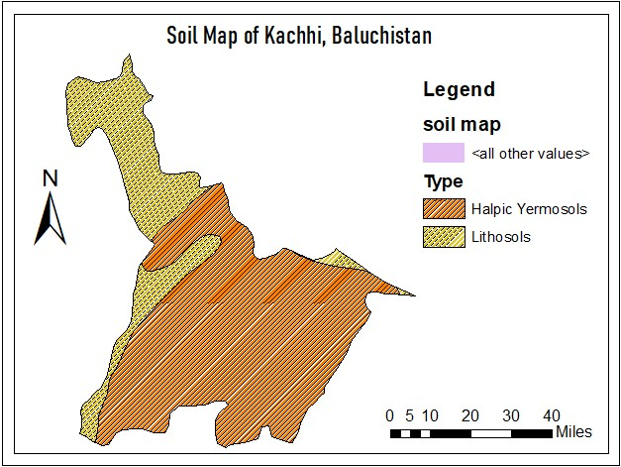

Slide 31
LULC
LULC affects the recharge processes
Create composite bands
Improvise Iso Cluster Unsupervised Classification
Identify the classified data from various band combination and google earth
Landsat 8 Images
Set Labels according to observation

Slide 32
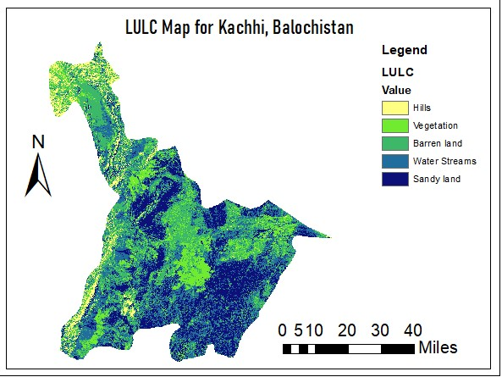

Slide 33
Drainage Density
Drainage Density controls the runoff distribution and infiltration rates
SRTM DEM Image
Hydrology tool Fill
Hydrology Tool Fill Direction
Hydrology Tool Flow accumulation
Condition tool to set Value > 500 for flow accumulation raster in comparison with true DEM raster
Hydrology tool Stream order
Hydrology tool Stream to feature
Density tool Line Density with process extent same as our AOI boundary
Reclass tool Reclassify
Raster to polygon

Slide 34
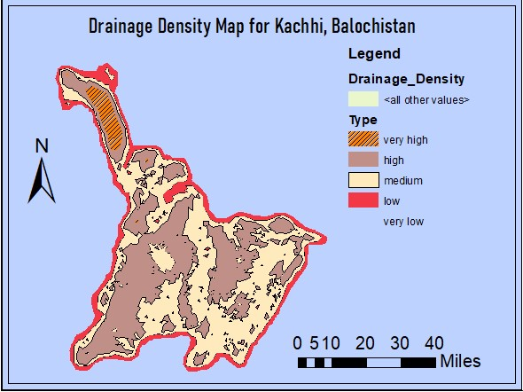

Slide 35
Groundwater Potential
To depict groundwater zones we perform overly analysis
Perform Analytical Hierarchy Proccessing
Set the parameter according to preference in the hierarchy
Set individual weights for parameter components
Add the component weights in the thematic map shapefile attribute table for each parameter
From Analysis go to overlay tools and perform Union
Add all the individual weights of components of each parameter and merge into one column in the attribute table using Field Calculator

Slide 36
Analytical Hierarchy Process
Factors | Geology | LD | Slope | Soil | LULC | DD | Weight
Geology | 6 | 5 | 4 | 3 | 2 | 1 | 0.41
Lineament density | 6/2 | 5/2 | 4/2 | 3/2 | 2/2 | 1/2 | 0.34
Slope | 6/3 | 5/3 | 4/3 | 3/3 | 2/3 | 1/3 | 0.27
Soil | 6/4 | 5/4 | 4/4 | 3/4 | 2/4 | 1/4 | 0.20
LULC | 6/5 | 5/5 | 4/5 | 3/5 | 2/5 | 1/5 | 0.13
Drainage Density | 6/6 | 5/6 | 4/6 | 3/6 | 2/6 | 1/6 | 0.068
Total |  |  |  |  |  |  | 1

Slide 37
Factors | Weight | Rank | Overall
Geology
Jurassic metamorphic and sedimentary rock | 41 | 1 | 41
Neogene sedimentary rock |  | 2 | 82
Paleogene sedimentary rock |  | 4 | 164
Quaternary sediment |  | 5 | 205
Lineament Density
Very low | 34 | 1 | 34
Low |  | 2 | 68
Medium |  | 3 | 102
High |  | 4 | 136
Very High |  | 5 | 170

Slide 38
Factors | Weight | Rank | Overall
Slope
0-2 | 27 | 5 | 135
2-5 |  | 4 | 108
5-10 |  | 3 | 71
10-20 |  | 2 | 54
> 20 |  | 1 | 27
Soil
Halpic Yermosols | 20 | 1 | 20
Lithosols |  | 3 | 60

Slide 39
Factors | Weight | Rank | Overall
LULC
Hills | 13 | 2 | 26
Vegetation |  | 5 | 65
Water streams |  | 3 | 39
Barren Land |  | 2 | 26
Sandy land |  | 1 | 13
Drainage Density
Very low | 6.8 | 5 | 34
Low |  | 4 | 27.2
Medium |  | 3 | 20.4
High |  | 2 | 13.6
Very High |  | 1 | 6.8

Slide 40
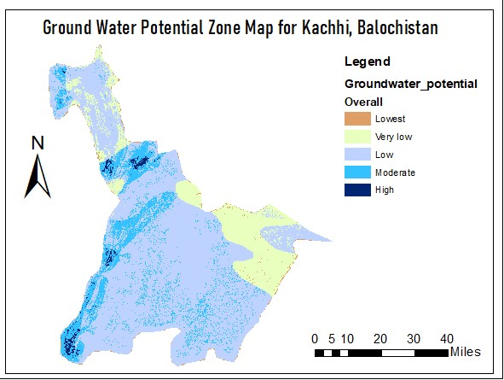

Slide 41
References
https://www.sciencedirect.com/science/article/abs/pii/S2352801X18302339#:~:text=The%20remote%20sensing%2C%20GIS%20and,delineate%20the%20groundwater%20potential%20zones.&text=The%20four%20groundwater%20potential%20zones,'%2C%20and%20'poor'.&text=The%20well%20discharge%20data%20have%20used%20for%20validation%20of%20groundwater%20potential%20zones.
https://pubs.usgs.gov/of/1997/ofr-97-470/OF97-470C/ofr97470C.pdf
https://www.gim-international.com/content/article/gis-for-hydrological-modelling#:~:text=Hydrological%20models%20predict%20discharges%20at,derived%20parameters%20such%20as%20slope.
https://www.nature.com/articles/s41598-019-38567-x
https://www.hindawi.com/journals/ace/2020/1273603/
https://en.wikipedia.org/wiki/Kacchi_Plain

